Slide 1
Precipitation Reactions
Writing Ionic Equations

Slide 2
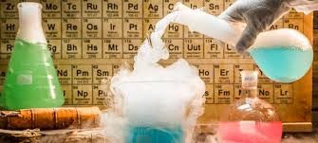
Outline
Precipitation reactions
Writing net ionic equations

Slide 3
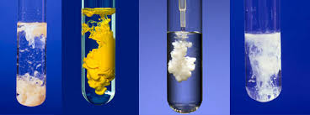
Precipitation reactions
Not all compounds dissolve completely in water – many dissolve to small extent (slightly soluble) while some do not dissolve at all (insoluble)
A precipitation reaction occurs when a solid forms from a previously clear solution, the solid that forms is called the precipitate

Slide 4
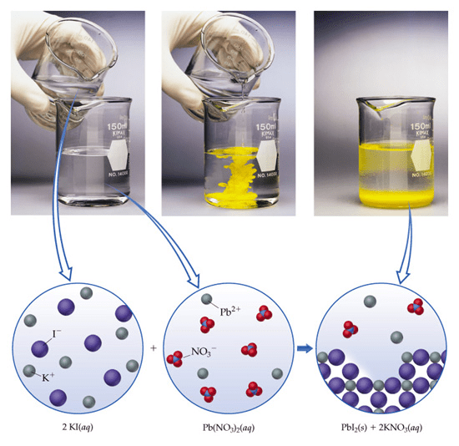
Precipitation reactions
A precipitation reaction occurs when a solid forms from a previously clear solution, the solid that forms is called the precipitate
REMEMBER: OBSERVATION THEN INFERENCE!

Slide 5
Precipitation reactions
Most ionic compounds contain only two types of ions – one positive and one negative, so when two ionic compounds are combined there can only be four combinations
Solution 1: KI_{(s)} → K⁺_{(aq)} + I⁻_{(aq)}
Solution 2: Pb(NO₃)_{2(s)} → Pb²⁺_{(aq)} + 2NO₃⁻_{(aq)}
Possible combinations of ions: KI , Pb(NO₃)₂ , PbI₂, KNO₃
Solvation equations
How do we know if a reaction has occurred?
We use the Solubility Table in our Data booklet to see if any of the four compounds have low/no solubility in water

Slide 6
Precipitation reactions
Solution 1: KI → K⁺ + I⁻
Solution 2: Pb(NO₃)₂ → Pb²⁺ + 2NO₃⁻
Possible combinations of ions:
KI , Pb(NO₃)₂ , PbI₂, KNO₃
S
S
IS
S

Slide 7
Precipitation reactions: How to Predict Precipitates
Precipitation reactions are most likely to happen where insoluble or low solubility compounds are involved (Solubility Table)
Step 1: write the reactants as they actually exist before any reaction occurs (free mobile ions)
Step 2: consider the various solids that could form. To do this simply exchange the anions
Step 3: use the solubility rules to decide whether a solid forms and, if so, to predict the identity of the solid

Slide 8
Writing Full Chemical Equations
Chemical reaction reactants disappear ➔ products form
Total mass & number of atoms present unchanged
A + B ➔ C + D
Reactants products
Step 1: write the correct formula of reactants & products
Step 2: place coefficients in front of formula to balance number of individual atom on each side (usually metals first) Law of Conservation of Matter
Step 3: write subscripts (g), (s), (l), (aq) to show physical state

Slide 9
Writing Net Ionic Equations
Chemical reactions that happen in aqueous solution
Dissolved substances are mainly present as ions
Substances which do not take part in the reaction spectator ions not involved in net ionic equation

Slide 11
Writing Net Ionic Equations
Step 1: write a balanced equation first
Step 2: rewrite in ion form formula of dissolved compounds Do not change solid, liquid or gas
Step 3: identify & remove spectator ions (ones that appear as aqueous on both sides of arrow)
Step 4: write Net Ionic Equation

Slide 12
Writing Net Ionic Equations - practice
Write the complete equation and net ionic equation for the reaction of aqueous sodium carbonate with aqueous barium nitrate
Na₂CO₃ + Ba(NO₃)₂ → NaNO₃ + BaCO₃
2
(aq)
(aq)
(aq)
(s)
2Na⁺ + CO₃²⁻ + Ba²⁺ + 2NO₃⁻ → 2Na⁺ + 2NO₃⁻ + BaCO₃
(s)
CO₃²⁻ + Ba²⁺ → BaCO₃
(aq)
(aq)
(s)

Slide 13
Precipitation reactions: Distinguishing between compounds
Precipitation reactions can be used to identify the presence of some particular ions
A few drops of a particular reagent can bring about solid forming reactions in some ionic compounds while others remain in solution
This technique only works if the substances to be distinguished contain at least one ion with different solubility patterns (colour included)

Slide 14
Precipitation reactions: Distinguishing between compounds
Step 1: identify and list the ions present in each of the unknown solutions
Step 2: refer to the solubility rules to identify any solubility in the ions present (colour included)
Step 3: based on this choose a suitable test reagent
Step 4: conduct the test and identify the unknowns from your observations

Slide 15
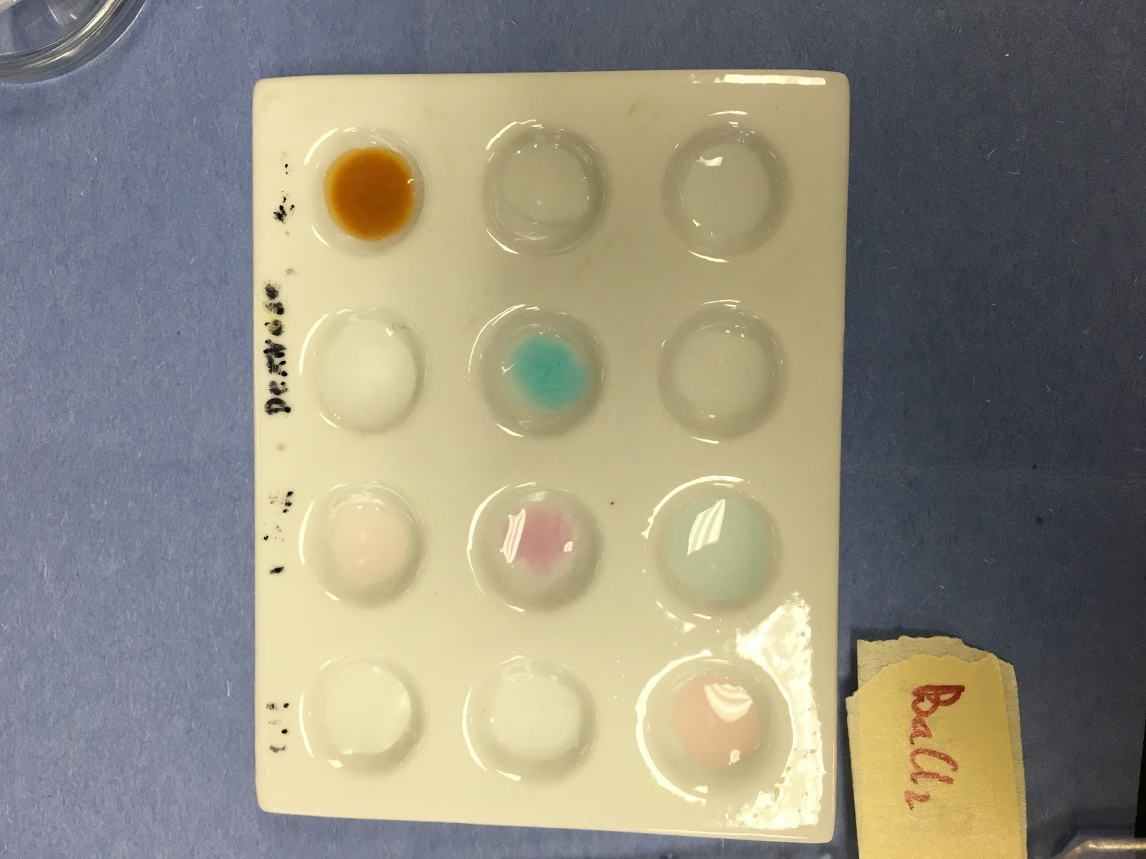
Precipitation reactions: Distinguishing between compounds
To save chemicals and make observations clearer we use well plates. (Tip – put a piece of paper under it and write what each column and row is)
remember – look for change of colour, formation of a precipitate, formation of bubbles, odours, temperature changes)

Slide 16
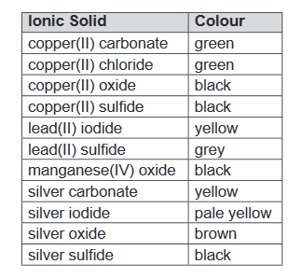
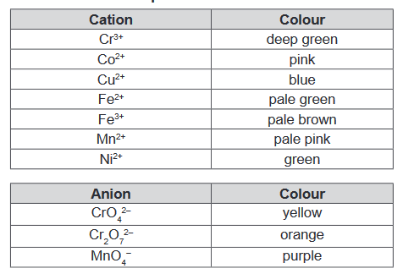
Colours of selected ions (Data Sheet)
In general, ionic solids have the same colour as that of any coloured ion they contain
Two colourless ions in general produce a white solid
Selected exceptions are in the Data Sheet

Slide 17
Precipitation reactions: Distinguishing between compounds
Example: You have two solutions, one contains barium chloride and the other barium iodide. Describe how you would do chemical tests based on precipitation reactions to distinguish between them.
Both contain barium, Ba²⁺ so this cannot be used to distinguish between them
One contains I⁻ and the other Cl⁻, so need a test that forms a precipitate with iodide but not chloride or vice versa
Look at solubility table – find a cation that forms a ppt with one but not the other
Silver ion would form solid AgI and solid AgCl but silver iodide is yellow and silver chloride is white.
Find a source of silver ions that won’t interfere with the barium in solution. Nitrates are perfect, the don’t form any solid precipitates

Slide 18
STAWA Experiment 22 – solubilities
Series of precipitation reactions to determine solubility rules for yourself
To practice your new skill of predicting products and writing net ionic formula, you will complete a table of cations vs anions that you will then actually test in class on Monday.

Slide 19
STAWA Experiment 22 – solubilities
For each combination predict if there will be a precipitate and if there is, what is it? [Use the solubility table in your data booklet to do this]
Write balanced net ionic equations for the precipitation reaction (the mixtures that form a solid)
Predict experimental observations – Before (what the two solutions look like before mixing) and after (what the now combined mixture looks like). This should include colours and formation of a precipitate.

Slide 20
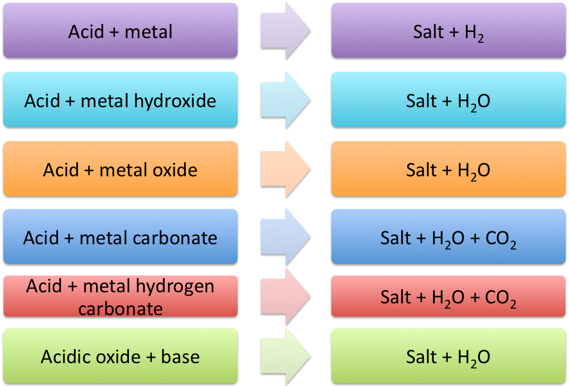
Reactions with acids (to be covered later but for those reading ahead)

Slide 21
Reactions of acids and bases

Slide 22
Practice Questions
Net ionic equation worksheets
Pearson 16.1 review
Finish Pearson 15 chapter review

